Slide 1
Digging For Reactions
Level 4_5 Group 18
Bailey Keeble
Ionut Ciobanu
Jack Fuller

Slide 2
The game
Adversial
Turn Based
Strategy involved

Slide 3
Features
Score System
The amount of blocks destroyed with one click will improve your score. (e.g destroying 2 blocks, doubles your points, 3 blocks triples your points etc).
Timer
There will be an overall timer that will count down the round, the person with the highest score at the end wins.
Gravity
The first person who touches the floor after getting rid of all their blocks is the winner.

Slide 4


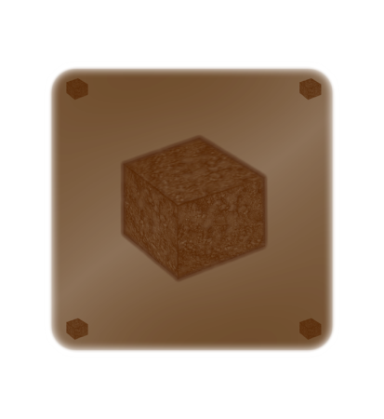

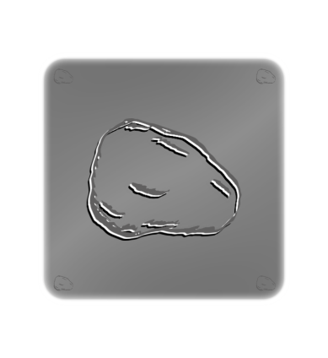

Grass
Fire
Ice
Mud
Blocks
Stone
Water

Slide 5

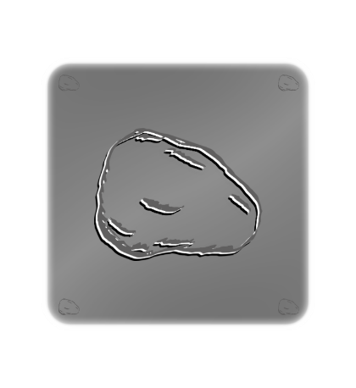



Combinations
Water beats Fire
>

Slide 6

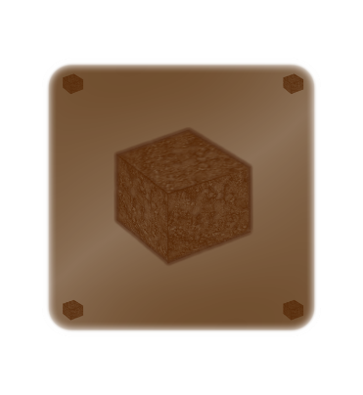




Ice freezes Water
+
=

Slide 7




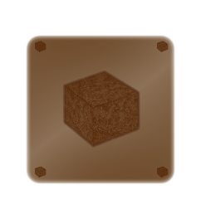

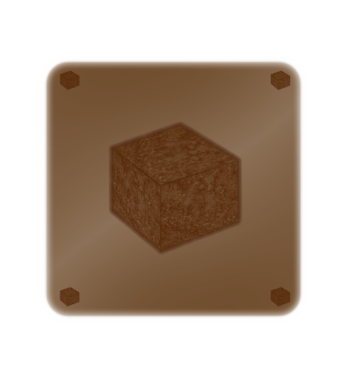
Water on top of Mud forms Grass
+
=

Slide 8
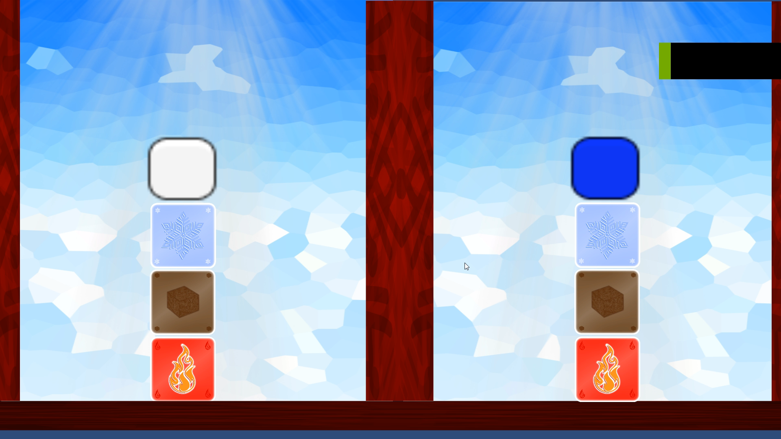
Clip from Game

Slide 9
Fun in our game
Competition spirit
Small competition between friends
Competition to beat the highest score
Tension
Not knowing if the other player got a higher score during their turn
Multiple blocks combinations
Lots of different opportunities and chances to get ahead of your opponent by strategically planning out your next move

Slide 10
Things still to do
Construct the timer
Program the combinations
Make a scoreboard
Produce a Main Menu
At the start of the game, the blocks are random.

Slide 11
Questions?

